Slide 1

FourthWall
Group 26

Slide 2
Team Introduction
Adam Mulvihill | Third Year - ICS
Daniel Whelan | Third Year - CSB
Xiaolei Zhang | Third Year - ICS
Daniel Madaghjian | Second Year - CSB
Tamunotonye Harold Karibiye | Second Year - ICS
Haojun Xing | Second Year - ICS

Slide 3
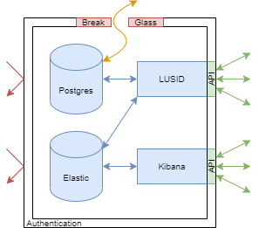
Project Description
Finbourne tasked us with creating a monitoring system that will collect statistics on databases they contain in Kubernetes clusters.
Currently, a “Break-Glass” procedure must be used in order to access these statistics
Our goal was to minimise the frequency at which the “Break-Glass” procedure is used and in turn make it easier for required statistics to be aggregated and examined.

Slide 4
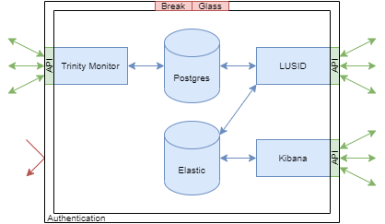
Solution
We developed monitoring system that will be deployed with each database instance.
This system polls the database and collect statistics about the database and is stored in a File System.
This information is requested by an authenticated REST API.
This cuts out the requirement for “Break-Glass” to be used to view database information.

Slide 5







Technologies Used

Slide 6



Implementation
Monitoring System polls the Database.
It collects DB info on statistics, Index Usage, Long Running Queries etc.
This is then converted into bytes and stored in a Binary Large Object Storage System.
The API contacts the Monitoring System through GET and POST requests.
Information is retrieved from the BLOB Storage and sent to the API.
The API serializes this a JSON and returns to the client.
Monitoring System
API

Slide 7
Main Challenges
In the Beginning
We all had to learn how to work with C# for both the API and Monitoring System.
Some of us also had to learn how to work with GitHub for committing our code.
Weeks of research was required for determining how best we could implement the system and what algorithms would be best suited for collecting and compiling the data
Progress Blockages
There was difficulty implementing the BLOB Storage System.
Adding authentication to the API proved challenging.
These occurred as we wanted to find ways that our client could easily implement their own BLOB Storage and Authentication System after handover was complete.

Slide 8
Project Reflections
What Went Right
What We’d Change
Very Lucky to have such a helpful and cooperative client
Team Worked Strongly together to overcome any progress blockers
Ensured strong understanding from everyone in the team at any one time.
API and Monitoring System sub-teams at times felt they were working on two separate projects.
Could have planned committing data better as there were many merge conflicts.
Overall, Very happy with all the work that the team put into the project.
Notes:
We felt we were very lucky to work with such a helpful and cooperative Client. Jim from Finbourne was only ever an email away if we ever needed help. As a result this helped the project flow more smoothly as a whole.
If there was a progress blocker, we felt the team worked well together to overcome the challenge and hence prevented any major stalling in the project timeline.
At any given point in time during the project we ensured that every member of the team had a strong understanding of their current task and did not feel like they were left in the dark with what they had been given to do.

Slide 9
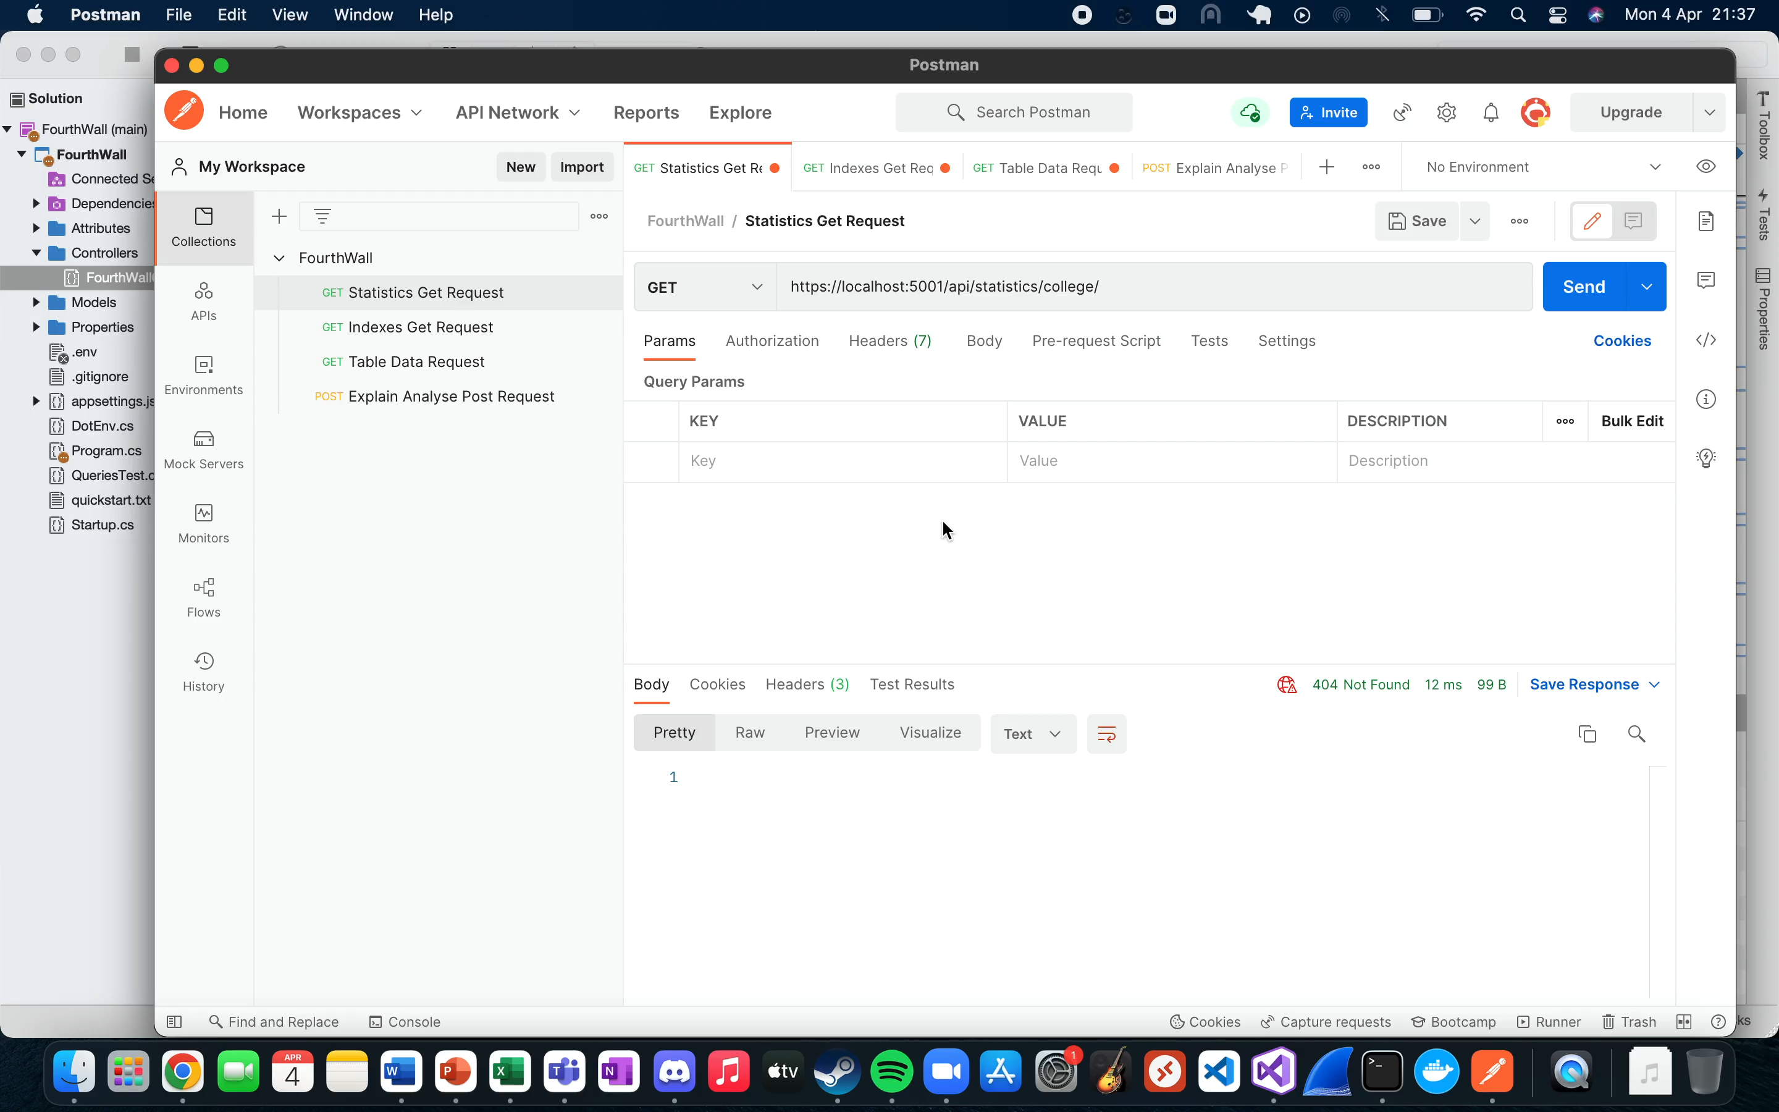
Demonstration
https://drive.google.com/file/d/1WsLe0EVXrWIDJ1TfRiYVrjSUajLv20i1/view?usp=sharing

Slide 10
Thanks For Listening!

